Slide 1
TCP / IP Suit

Slide 2
What is TCP / IP?
TCP/IP stands for Transmission Control Protocol / Internet Protocol and is a suite of communication protocols used to interconnect network devices on the Internet.
TCP/IP is also used as a communications protocol in a private computer network (an intranet or extranet).

Slide 3
TCP / IP
The Internet Protocol (IP) is the address system of the Internet and has the core function of delivering packets of information from a source device to a destination device.

Slide 4
TCP / IP
IP is the primary way in which network connections are made, and it establishes the basis of the Internet.
IP does not handle packet ordering or error checking.
Such functionality requires another protocol, often the Transmission Control Protocol (TCP).

Slide 5
Two Layers
The TCP/IP protocol is divided into two layers: the Transport layer and the Internet layer.
The Transport layer is responsible for ensuring that data is transmitted reliably from one device to another.

Slide 6
TCP and UDP
This layer is comprised of two protocols: the Transmission Control Protocol (TCP) and the User Datagram Protocol (UDP).

Slide 7
TCP vs. UDP
TCP is used for reliable data transmission, while UDP is used for fast transmission of data that can tolerate some packet loss.

Slide 8
IP
The Internet layer is responsible for transmitting data packets between devices.
This layer is comprised of two protocols: the Internet Protocol (IP) and the Address Resolution Protocol (ARP).

Slide 9
IP vs. ARP
IP is responsible for routing data packets between devices, while ARP is used to map IP addresses to physical addresses.

Slide 10
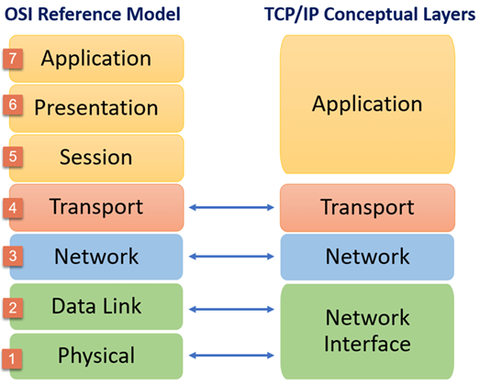
OSI vs. TCP/IP

Slide 11
Application Layer
The application layer provides applications with standardized data exchange.
Its protocols include HTTP, FTP, Post Office Protocol 3, Simple Mail Transfer Protocol and Simple Network Management Protocol.

Slide 12
Transport Layer
The transport layer is responsible for maintaining end-to-end communications across the network.
TCP handles communications between hosts and provides flow control, multiplexing and reliability.
The transport protocols include TCP and User Datagram Protocol

Slide 13
Network Layer
The network layer, also called the internet layer, deals with packets and connects independent networks to transport the packets across network boundaries.
The network layer protocols are IP and Internet Control Message Protocol, which is used for error reporting.

Slide 14
Physical Layer
The physical layer, also known as the network interface layer or data link layer, consists of protocols that operate only on a link.
The protocols in this lowest layer include Ethernet for local area networks and Address Resolution Protocol.

Slide 15
Transport Layer Protocol

Slide 16
Transport Layer Protocol
The transport Layer is the second layer in the TCP/IP model and the fourth layer in the OSI model.
It is an end-to-end layer used to deliver messages to a host.

Slide 17
Transport Layer Protocol
Transport Layer provides communication services to the application processes that are running on different hosts.
Transport Layer provides the services to the session layer and it receives the services from the network layer.

Slide 18
Transport Layer Protocol
The services provided by transport layer include error correction as well as segmenting and desegmenting data before and after it's sent on the network.

Slide 19
Transport Layer Protocol
Transport layer also provides the flow control functionality and ensures that segmented data is delivered across the network in the right sequence.

Slide 20
Services Provided By Transport Layer

Slide 21
Services
Process to Process Communication
Addressing
Reliable delivery
Flow control
Congestion avoidance

Slide 22
Process to Process Communication
Transport Layer is responsible for delivery of message to the appropriate process.
Transport Layer uses a port number to deliver the segmented data to the correct process amongst the multiple processes that are running on a particular host.

Slide 23
A port number is a 16-bit address used by transport layer to identify any client-server program.
Ports 20 and 21: File Transfer Protocol (FTP).
Port 53: Domain Name System (DNS).
Port 80: Hypertext Transfer Protocol (HTTP)
Port 123: Network Time Protocol (NTP)
Port 443: HTTP Secure (HTTPS)
Port 3389: Remote Desktop Protocol (RDP)

Slide 24
Flow Control
Flow control is used to prevent the sender from overwhelming the receiver.
If the receiver is overloaded with too much data, then the receiver discards the packets and asking for the retransmission of packets.

Slide 25
Flow Control
This increases network congestion and thus, reducing the system performance.
The transport layer is responsible for flow control.

Slide 26
Flow Control
It uses the sliding window protocol that makes the data transmission more efficient as well as it controls the flow of data so that the receiver does not become overwhelmed.

Slide 27
Congestion Control

